Slide 1

WELCOME TO ENGLISH CLASS

Slide 2
WELCOME TO ENGLISH CLASS
“No one has a problem with the first mile of a journey. Even an infant could do fine for a while. But it isn't the start that matters. It's the finish line."
Julien Smith

Slide 3
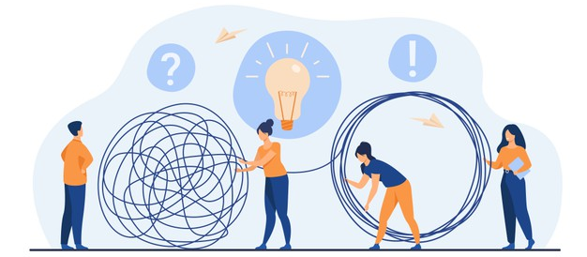
PROBLEM SOLVING AND CRITIQUING

Slide 4

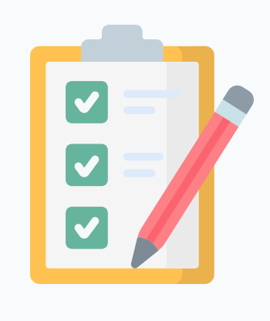

DATE
DATE
Objective:
Students will demonstrate their understanding of the text by analyzing and modifying information about critiquing.

Slide 5




AGENDA
WARM UP:
The difference between Criticize VS Critique?
CLASS ACTIVITY:
New Vocabulary
Reading Strategy: Rereading
Reading: Critiquing and Making Improvements
Wrap- Up
Sentence correction

Slide 6

WARM-UP
Criticize VS Critique?
Which do you think is personal?
Which is objective?
2. Which do you think is general?
Which is specific?
3. Which do you think destroys?
Which constructs?

Slide 7

VOCABULARY
Development / Develop
Improvement / improve
Share
Wrong
Recipe
Choice
Peer
Critique
Change

Slide 8
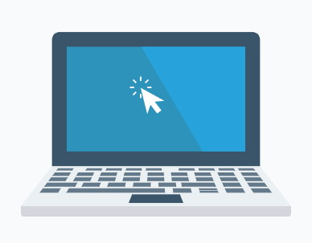
Complete the following sentences with the new vocabulary:
1. There are many good universities in Colombia. It is so difficult to make a ____________.
2. I didn´t pass the test because I had many _______ answers.
3. Criticism is personal but _________ is objective.
4. I have many good ideas. I want to ________ them with my teacher.
5. People who work in software ___________ create new programs.
6. My grandmother cooks delicious food. Her cheesecake __________ is the best.
7. I have bad grades. I need to ________ my grades to pass the course.
8. In virtual classes, it is difficult to interact with your __________.
9. I am very pessimistic. I need to ________ my attitude and become more optimistic.

Slide 9
Video Reading Strategy

Slide 10
Text Critiquing and Making Improvements
Problem solving is an ability that everyone can develop. Problem solving is related to creativity. On some occasions, creativity is the development of new ideas. But on other occasions, creativity is the improvement of the existing ideas. *stop* A lot of improvement comes through sharing the ideas we have and critiquing the ideas of others. *stop*
We will begin with the idea that there are no wrong answers. And logically, all answers can be improved. That's a good starting point. *stop* To critique, one has to accept this starting idea of the other person, and have ideas about how to improve that idea. A lot of this, we learn from our own lives. *stop*
When we cook and experiment with a new recipe, sometimes it's good and sometimes it's bad. When it is bad, we need ideas on how to improve the food. *stop* We can change the quantity of food, the ingredients, the temperature, the spices, or the portion size. By making these choices, we're critiquing the original food design, that is the recipe, because we want to improve the recipe for future use. *stop*
When we critique ideas, for example academic projects, the objective is to improve the idea and to help your peer improve their creative capacity.

Slide 11
Text Critiquing and Making Improvements
This means we must be respectful of the other person and while emphasizing problems or difficulties we must offer solutions to improve the ideas presented. *stop*
Sometimes, when you generate new ideas for any project, you can also change any aspect of the project. It is always good to ask yourself questions to wake up your creativity: *stop* Was it more creative, or less creative? Have you done something similar, or different? Or is this result something you've never even imagined? What would happen if you made the project bigger or smaller? Or something that touched more people or something that was a different color? *stop*
But the most important thing is that you shouldn´t destroy the ideas - it is necessary to construct on the original idea from your peers. Then of course, you apply the same process of critique honestly to your own work. *stop*
https://www.coursera.org/lecture/creative-problem-solving/critiquing-and-making-improvements-Y5Ru9

Slide 12
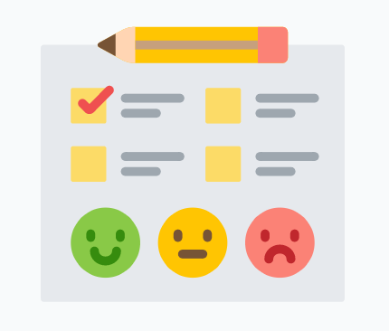
WRAP-UP
Correct these sentences. If necessary,
reread the text to find the right answers.
Creativity is only limited to creating new ideas.
Wrong answers cannot be improved.
When we critique academic projects, we say negative things about them.
When we critique, we focus on the problems.
When we critique, we destroy ideas.

Slide 13
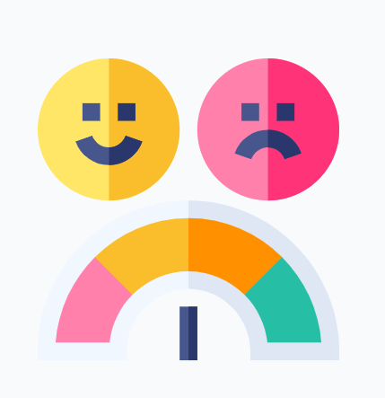
SELF-EVALUATION
Entiendo en qué consiste la estrategia de “rereading”.
Si No De pronto
2. La estrategia “reread” me ayuda a concentrarme más cuando leo un texto.
Si No De pronto
3. Cuando vuelvo a leer, entiendo el texto mejor.
Si No De pronto

